Slide 1
Module 3: Chapter 2 UNDERSTANDING DATA

Slide 2
DATA
Data is the raw form of information, a collection of facts, figures, symbols or observations that represent details about events, objects or phenomena. By itself, data may appear meaningless, but when organized, processed and interpreted, it transforms into valuable insights that support decision-making, problem-solving and innovation.

Slide 3
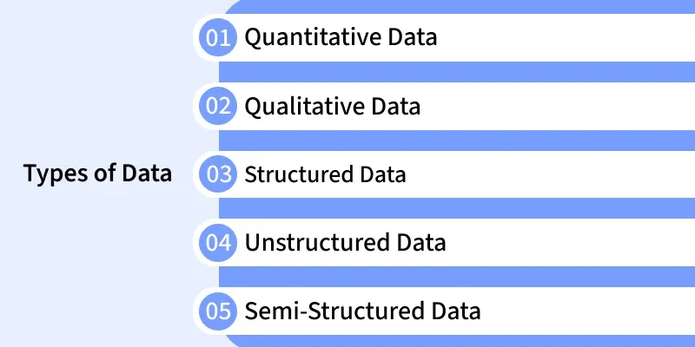
Types of Data

Slide 4
Quantitative Data
Quantitative data is information that can be measured, counted and expressed in numerical form. It provides objective values that can be analyzed statistically to identify patterns, trends and relationships.
Represents numbers and measurable values.
Can be divided into: Discrete data (Whole numbers) and Continuous data (Values on a scale).
Example: Age of people, number of customers visiting a store, temperature readings, sales revenue.
2. Qualitative Data
Qualitative data is descriptive, non-numeric information that explains qualities, characteristics or categories rather than quantities. It helps understand opinions, experiences and meanings behind behaviors.
Focuses on qualities, attributes and categories rather than numbers.
Example: Customer feedback (“satisfied”, “unsatisfied”), product colors, interview transcripts, social media comments.

Slide 5
3. Structured Data
Structured data is information organized into a predefined format (rows and columns) that makes it easily searchable and manageable by traditional databases.
Best suited for tasks requiring accuracy and consistency.
Example: Bank transactions, employee records, product inventories.
4. Unstructured Data
Unstructured data is raw information that does not follow a predefined structure or format making it harder to organize and analyze with conventional tools.
Accounts for over 80% of data generated globally.
Common in social media, multimedia and IoT applications.
Example: Emails, images, videos, voice recordings, PDF documents.
5. Semi-Structured Data
Semi-structured data combines aspects of structured and unstructured data. It does not reside in traditional tables but still contains tags or markers that provide a loose structure.
Example: JSON files, XML documents, NoSQL databases, sensor logs.

Slide 6
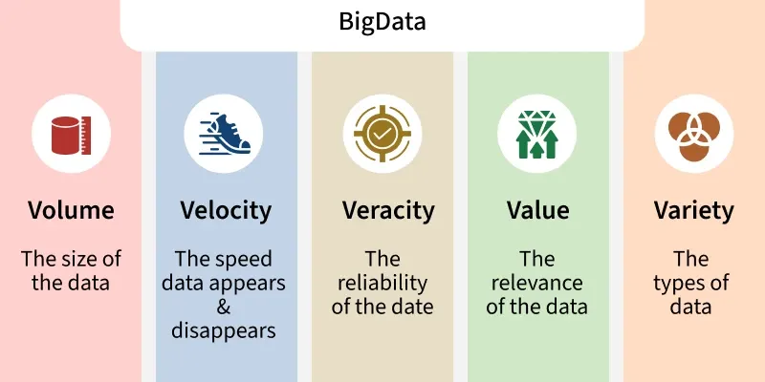
Big Data
When datasets grow in size, complexity and speed, traditional methods don’t suffice. Big Data refers to datasets that are too large, too varied or too fast to be handled by traditional data processing tools.

Slide 7
The defining characteristics often called the Vs of Big Data are:
Volume: Massive amounts of data.
Velocity: Speed of generation and processing.
Variety: Different formats: structured, unstructured, semi-structured.
Veracity: Accuracy, trustworthiness of data to deal with noise and errors.
Value: The usefulness of data i.e having data is not enough, we must extract value from data.

Slide 8
Big Data Analytics
Big data analytics is the process of analyzing large and complex datasets to uncover meaningful patterns, trends and insights that support data driven decision making.
It analyzes massive volumes of structured, semi-structured and unstructured data generated from data sources.
Advanced tools and frameworks like Hadoop, Spark and NoSQL databases support distributed storage and large scale data processing.

Slide 9
Types of Big Data Analytics
1. Descriptive Analytics
Summarizes historical data to understand what happened using metrics, dashboards and reports.
Helps identify trends, patterns and performance in past events such as sales or website traffic.
2. Diagnostic Analytics
Analyzes data to uncover reasons behind past outcomes and events.
Useful for identifying root causes, like reasons for customer churn or high patient readmissions.
3. Predictive Analytics
Uses historical data and statistical/machine learning models to forecast future events.
Applied in scenarios like predicting customer behavior, stock prices or weather trends

Slide 10
4. Prescriptive Analytics
Provides actionable recommendations to optimize future outcomes based on insights.
Used in pricing strategies, marketing campaigns and resource allocation decisions.
5. Real-time Analytics
Processes and analyzes data instantly as it is generated for immediate insights.
Enables quick decision-making in areas like fraud detection, stock trading and live traffic management.
6. Spatial Analytics
Examines location-based data to optimize operations and logistics.
Applied in urban planning, route optimization and analyzing customer movement patterns.
7. Text Analytics
Extracts insights from unstructured text data using natural language processing (NLP).
Used for sentiment analysis, trend detection and improving customer experience from reviews or social media.

Slide 11
Data Analytics Framework
Data Collection: Gather data from sources such as cloud platforms, IoT devices, social media, mobile apps and transactional systems. Data is stored in data lakes or warehouses.
Data Storage and Management: Organize, index and manage large datasets to ensure easy accessibility and efficient querying.
Data Processing: Transform and structure data using batch or stream processing techniques (e.g., Hadoop, Spark, Flink) to prepare it for analysis.
Data Cleaning: Refine data by removing duplicates, handling missing or inconsistent values and ensuring overall quality and reliability.
Data Analysis: Apply techniques like data mining, predictive analytics, machine learning, deep learning and NLP to identify patterns, trends and relationships.
Visualization and Insights: Present results through interactive dashboards, charts and reports to support informed, data-driven decision-making.
Decision and Action: Implement insights in business processes, generating new data and completing the analytics feedback loop.

Slide 12
Univariate Analysis
Univariate Analysis is a type of data visualization where we visualize only a single variable at a time. Univariate Analysis helps us to analyze the distribution of the variable present in the data so that we can perform further analysis.

Slide 13
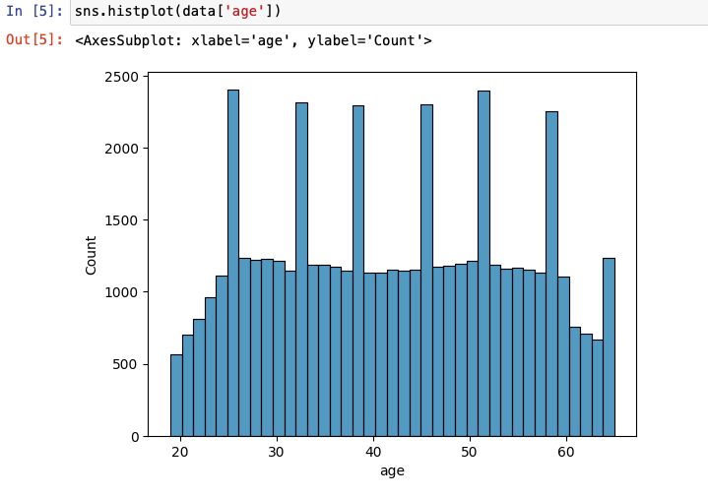
Histogram
Here we’ll be performing univariate analysis on Numerical variables using the histogram function.

Slide 14
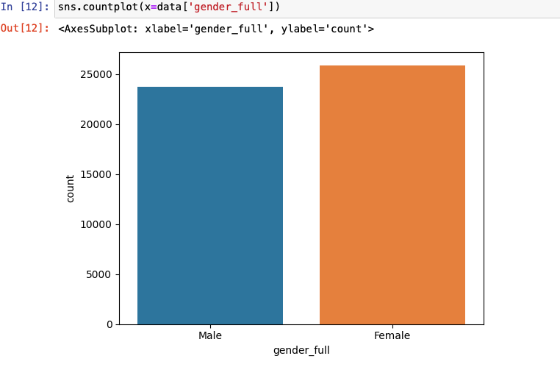
Bar Chart
Univariate analysis of categorical data. We’ll be using the count plot function from the seaborn library

Slide 15
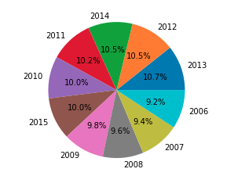
Pie Chart
A piechart helps us to visualize the percentage of the data belonging to each category.

Slide 16
Central Tendency
Measures of central tendency include mean, median, and mode, while measures of dispersion include range, variance, standard deviation, and interquartile range.
Mean: The mean, also known as the average, is calculated by summing up all the values in a dataset and dividing the sum by the total number of values. It is sensitive to extreme values, which means it is likely to have outliers.
Median: The median is the middle value in a dataset when the values are arranged in ascending or descending order. If there is an even number of values, the median is the average of the two middle values. The median experiences less impact from outliers than the mean does.
Mode: The mode is the value that occurs most frequently in a dataset. It is particularly useful for categorical data but can also be applied to numerical data. A dataset may have one mode (unimodal), two modes (bimodal), or more than two modes (multimodal).

Slide 17
Dispersion
Dispersion, also known as variability or spread, measures the extent to which individual data points deviate from the central value. It provides information about the spread or distribution of data points in a dataset.
Range: In statistics, the range refers to the difference between the highest and lowest values in a dataset. It provides a simple measure of variability, indicating the spread of data points. The range is calculated by subtracting the lowest value from the highest value.
For example, in a dataset {4, 6, 9, 3, 7}, the range is 9 - 3 = 6.
Variance: Variance is a statistical measure that quantifies the amount of variation or dispersion of a set of numbers from their mean value. Specifically, variance is defined as the expected value of the squared deviation from the mean.

Slide 18
Standard Deviation: Standard deviation is a measure of the amount of variation or dispersion of a set of values from the mean value. It is calculated as the square root of the variance, which is the average squared deviation from the mean.
Interquartile Range (IQR): Interquartile Range (IQR) is a measure of statistical dispersion that represents the middle 50% of a data set. It is calculated as the difference between the 75th percentile (Q₃) and the 25th percentile (Q₁) of the data, i.e., IQR = Q₃ − Q₁.

Slide 19
Central Tendency | Dispersion
Indicates the typical or central value around which data tends to cluster | Indicates the spread or variability of data points in a dataset
Provides a single representative value summarizing the dataset | Describes how spread out the values are from each other and from the central value
Mean, median, mode | Range, variance, standard deviation, interquartile range
Calculated using the values of the dataset | Calculated using deviations from the central value (usually the mean)
Helps in understanding the center of the data distribution | Helps in understanding the spread of the data distribution
Indicates where the data is centered | Indicates how widely the data is spread out

